Slide 1
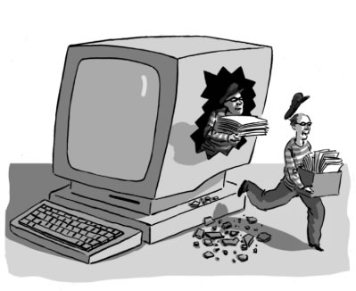

Practical Security (Cracking Windows Password)
Lesson 1
Asad Raza
asadraza@gmail.com

Slide 2
Types of User Authentication
Passwords
Vary in complexity and hack-ability
Smart Cards
Two factor Authentication
Biometric Security
Secure but expensive

Slide 3
Common passwords
password ,abc123, qwerty123 ,123456 etc
Survey conducted by a British bank
Common passwords
23% child's name
19% partner's name
12% birthdays
9% football team
9% celebrities and bands
9% favorite places
8% own name
8% pet's name

Slide 4
How Windows Store Passwords
Windows does not store passwords in clear text
Passwords go through a process to generate an LM hash and an NT hash
Hashes are one-way mathematical functions
hashed passwords cannot be reverse engineered.
Lan Manager or LM Hash
1. Convert password to upper case
2. Pad the plaintext with null characters to make it 14 bytes long.
3. Split into two 7 character (byte) chunks
4. Use each 7 byte chunks separately as keys to DES -encrypt an ASCII constant string
5. Concatenate the two cipher texts from step 4 to product the hash.
6. Store the hash in the SAM file.

Slide 5
How Windows Store Passwords
NT Hash
Take the Unicode mixed‐case password and use the Message Digest 4 (MD4) algorithm to obtain the hash.
Store the hash in the SAM file.
The LanMan hash is only stored for passwords that are 14 characters or fewer
The NT Hash handles passwords up to 128 characters in length

Slide 6
Location of SAM file
Both NT and LM Hashes are stored in SAM file
C:\windows\system32\config\SAM

Slide 7
Password cracking Methodologies
Brute force attack
Dictionary attack
Rainbow tables
“It can crack the password Fgpyyih804423 in 160 seconds.”
Jeff Atwood

Slide 8
Password cracking applications and web sites
Backtrack
Lopht crack
SAMinside
Ophcrack
Samdump2
Bkhive
John The Ripper

